Slide 1
Text Summarization
Statistical Models with Worked Examples

Slide 2
Major Statistical Approaches
Statistical text summarization selects the most important information from a document using statistical features such as word frequency, TF-IDF, sentence position, sentence length, and similarity.
Frequency-based summarization
TF-IDF-based summarization
TextRank
LexRank
Feature-based sentence scoring

Slide 3
1. Frequency-Based Summarization
Sentences containing more important/frequent words are more important.
Example:
S1: Machine learning is an important technology in healthcare.
S2: Machine learning helps doctors analyze patient data.
S3: Doctors use healthcare systems to store patient information.
S4: Machine learning can predict diseases from medical data.

Slide 4
Step 1: Preprocessing
Remove stop words such as: is, an, in, the, to, from, can
The sentences become approximately:
Sentence | Important words
S1 | machine, learning, important, technology, healthcare
S2 | machine, learning, helps, doctors, analyze, patient, data
S3 | doctors, use, healthcare, systems, store, patient, information
S4 | machine, learning, predict, diseases, medical, data

Slide 5
Step 2: Word frequency
Word | Frequency
machine | 3
learning | 3
healthcare | 2
doctors | 2
patient | 2
data | 2
important | 1
technology | 1
helps | 1
analyze | 1
use | 1
systems | 1
store | 1
information | 1
predict | 1
diseases | 1
medical | 1

Slide 6
Step 3: Sentence score
Calculate:
Rank | Sentence | Score
1 | S2 | 14
2 | S4 | 11
3 | S1 | 10
4 | S3 | 10
S1 = 3+3+1+1+2=10
S2 = 3+3+1+2+1+2+2=14
S3 = 2+1+2+1+1+2+1=10
S4 = 3+3+1+1+1+2=11
Limitation
Frequency alone can select repetitive or less informative sentences because it does not consider how common a word is across the whole document.
This leads to TF-IDF-based summarization.

Slide 7
2. TF-IDF-Based Text Summarization
TF-IDF is one of the most useful statistical techniques for explaining extractive summarization. A word is important if it occurs frequently in a sentence/document but is not common across all documents.
Worked Example
Consider three short documents:
D1: Machine learning improves healthcare prediction.
D2: Machine learning helps doctors analyze healthcare data.
D3: Doctors use medical data for disease prediction.
Suppose we want to summarize D1.

Slide 8
Step 1: Calculate Term Frequency
TF(t,d)=Number of occurrences of t​/Total number of words in d
D1 has 5 words: machine learning improves healthcare prediction
For the word machine: TF(machine,D1) = 1/5 =0.2
Word | TF
machine | 0.2
learning | 0.2
improves | 0.2
healthcare | 0.2
prediction | 0.2

Slide 9
Step 2: Calculate IDF
For improves:
It occurs only in D1.
df(improves)=1 IDF(improves)=log₁₀(3) IDF(improves)=0.477
Thus, improves is more discriminative than machine.
where:
N=3 documents
df(t) = number of documents containing the word
For machine:
Machine occurs in D1 and D2. df(machine)=2
IDF(machine) =
IDF(machine)≈0.176

Slide 10
Step 3: Calculate TF-IDF
TFIDF(t,d)=TF(t,d)×IDF(t)
For machine: TFIDF(machine,D1) = 0.2 X 0.176 =0.0352
For improves: TFIDF(improves,D1) = 0.2X 0.477 =0.0954
A summary system can calculate the TF-IDF score of the words in every sentence and then calculate the sentence score.

Slide 11
3. TF-IDF Sentence Scoring
Consider the following document:
S1: Artificial intelligence is transforming healthcare.
S2: Artificial intelligence helps doctors diagnose diseases.
S3: Hospitals use AI systems to manage patient records.
S4: AI can also predict diseases using medical data.
Suppose we want two sentences.
After preprocessing, assume the important words are:

Slide 12
Word | Weight
artificial | 0.8
intelligence | 0.8
healthcare | 0.9
doctors | 0.85
diagnose | 0.9
diseases | 0.7
hospitals | 0.9
systems | 0.8
patient | 0.85
records | 0.9
predict | 0.95
medical | 0.85
data | 0.75

Slide 13
Sentence Scores
Now calculate sentence scores by summing the TF-IDF weights.
S1 : Score(S1)=0.80+0.80+0.90 =2.50
S2 : Score(S2)=0.80+0.80+0.85+0.90+0.70 =4.05
S3 : Score(S3)=0.90+0.80+0.85+0.90 =3.45
S4 : Score(S4)=0.95+0.70+0.85+0.75 =3.25

Slide 14
Final ranking and summary
Ranking
Extractive summary
Rank | Sentence | Score
1 | S2 | 4.05
2 | S3 | 3.45
3 | S4 | 3.25
4 | S1 | 2.5
Artificial intelligence helps doctors diagnose diseases. Hospitals use AI systems to manage patient records.

Slide 15
4. TextRank
TextRank is a graph-based statistical summarization method. Instead of directly calculating the frequency of words, TextRank asks: Which sentences are most connected to other important sentences? A highly connected sentence tends to receive a higher TextRank score.
For example:
S2
/ \
0.7 0.6
/ \
S1 ------ S3
0.5

Slide 16
Example : TextRank
Consider four sentences:
S1: Machine learning is useful in healthcare.
S2: Machine learning helps doctors analyze medical data.
S3: Doctors use medical data to diagnose diseases.
S4: Machine learning is also used in agriculture.
Assume cosine similarity between sentences has already been calculated as:

Slide 17
Step 1: Initialize scores
Initially: S1=S2=S3=S4=1
Damping factor d=0.85
TextRank formula:

Slide 18
Step 2: Calculate Row Sums in TextRank
 | S1 | S2 | S3 | S4
S1 | – | 0.6 | 0.2 | 0.5
S2 | 0.6 | – | 0.7 | 0.3
S3 | 0.2 | 0.7 | – | 0.1
S4 | 0.5 | 0.3 | 0.1 | –
Sentence | Similarity values | Row Sum
S1 | 0.60 + 0.20 + 0.50 | 1.3
S2 | 0.60 + 0.70 + 0.30 | 1.6
S3 | 0.20 + 0.70 + 0.10 | 1
S4 | 0.50 + 0.30 + 0.10 | 0.9

Slide 19
Step 3: First iteration for S1
Contribution from S2
Similarity between S2 and S1: w₂₁=0.60
Row sum of S2: 1.60
Current score of S2: TR(S2)=1
Therefore:(0.60/1.60) X1 =0.375
Contribution from S3
Similarity between S3 and S1: w₃₁​=0.20
Row sum of S3: 1
Current score of S3: TR(S3)=1
Therefore:(0.20/1) X1 =0.20
Contribution from S4
Similarity between S4 and S1: w₄₁​=0.50
Row sum of S4:.90
Current score of S3: TR(S3)=1
Therefore:(0.50/0.90) X1 =0.556
Add the contributions:
TR(S1)=0.15+0.85[0.375+0.20+0.556]
=1.11

Slide 20
Results after Iteration 1
Sentence | TextRank Score
S1 | 1.111
S2 | 1.421
S3 | 0.748
S4 | 0.722
Therefore, if two sentences are required:
S2: Machine learning helps doctors analyze medical data.
S3: Doctors use medical data to diagnose diseases.
TextRank is not simply counting words. It determines sentence importance based on the importance of neighboring sentences.

Slide 21
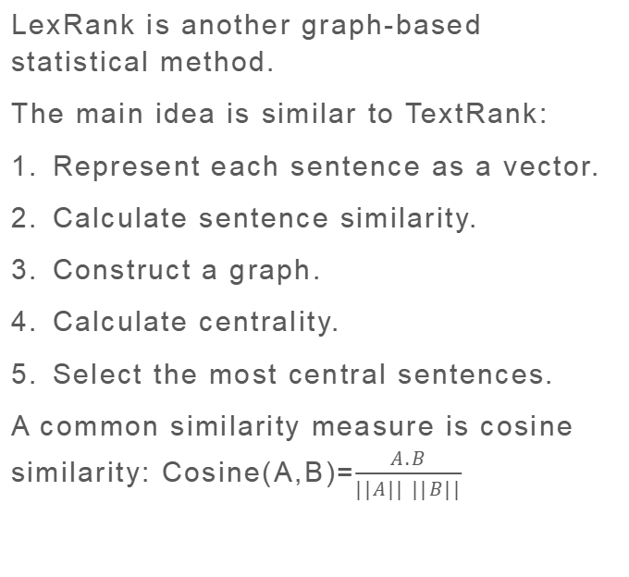
5. LexRank
LexRank is another graph-based statistical method.
The main idea is similar to TextRank:
Represent each sentence as a vector.
Calculate sentence similarity.
Construct a graph.
Calculate centrality.
Select the most central sentences.
A common similarity measure is cosine similarity: Cosine(A,B)=$\frac{A.B}{||A|| ||B||}$​
Cosine(S1,S2)=0.85
Cosine(S1,S3)=0.10
they are very different.
LexRank identifies sentences that are central to the overall document.

Slide 22
6. Feature-Based Statistical Summarization
Another statistical approach combines several sentence-level features.
Score(S)=w₁​F_{position}​+w₂​F_{length}​+w₃​F_{frequency}​+w₄​F_{TFIDF}​
Feature | Weight
Position | 0.3
Word frequency | 0.25
TF-IDF | 0.3
Length | 0.15

Slide 23
For sentence S1
F_{position}​=0.90
F_{frequency​}=0.70
F_{TFIDF}​=0.80
F_{length}​=0.60
Score(S1)=(0.30)(0.90)+(0.25)(0.70)+(0.30)(0.80)+(0.15)(0.60)
  =0.27+0.175+0.24+0.09
  =0.775

Slide 24
Comparison of Statistical Models
Model | Main principle | Type | Important calculation
Frequency-based | Frequent words indicate importance | Extractive | Word frequency
TF-IDF | Important/discriminative words | Extractive | TF × IDF
TextRank | Sentence graph centrality | Extractive | PageRank
LexRank | Sentence centrality | Extractive | Cosine + eigenvector/PageRank
Feature-based | Combine multiple features | Extractive | Weighted score

